Slide 1
EXERCISES
1. Find Fourier series representation of waveform shown and plot Fourier series representation, the amplitude and phase for
i) 10 coefficients ii) 30 coefficients iii) 50 coefficients

Slide 2
EXERCISES
2. Find the Fourier series of
using Matlab and plot both the amplitude and phase of the harmonics.
3. Find the Fourier series of
using Matlab and plot both the amplitude and phase of the harmonics.

Slide 3
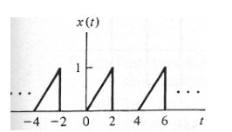
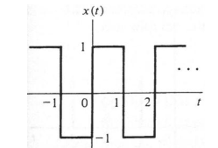
EXERCISES
4. Use Matlab to perform symbolic Fourier series calculation of the following signals. Plot both the amplitude and phase of the harmonics.
i) ii)

Slide 4
EXERCISES
5. Let f (x) be a function of period 2π such that
Use Matlab to perform symbolic Fourier series calculation of the above signal. Plot both the amplitude and phase of the harmonics.

